Slide 1
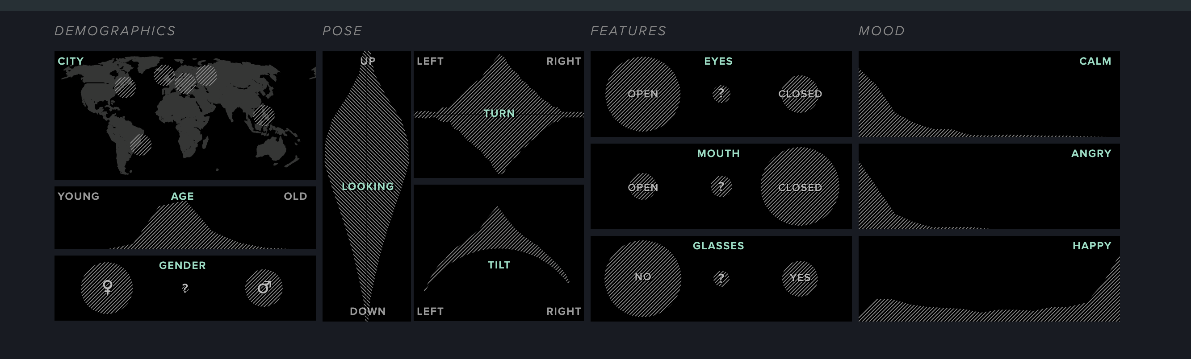
The SELFIEXPLORATORY is part of SELFIECITY

Slide 2
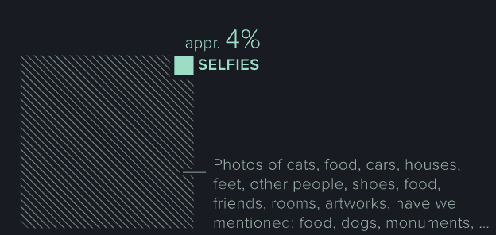
Brief Introduction
SelfieCity, a study designed to examine and analyze how people take their selfies across the world
In this graphic it includes area plots, frequency plots, violin plots, and count plots

Slide 3
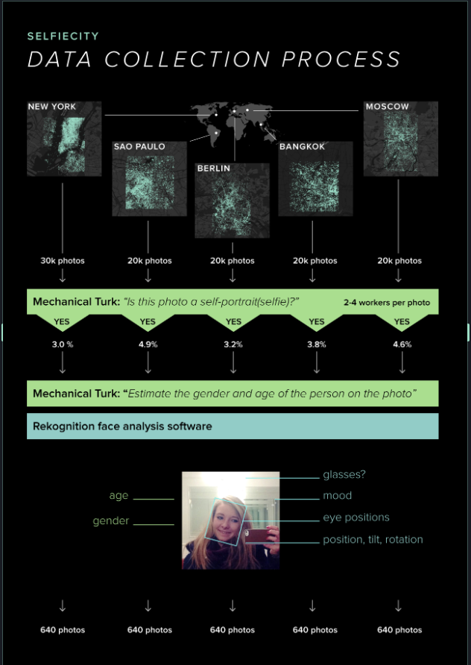

Slide 4
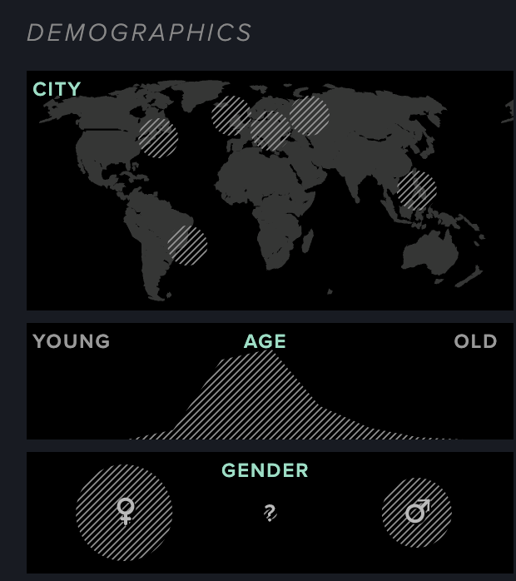
Demographics
Five major cities
Wide range of…
Ages
Gender

Slide 5
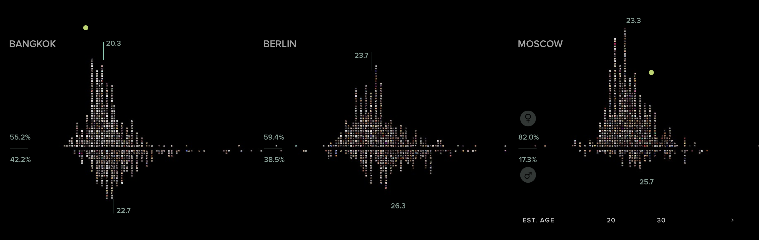
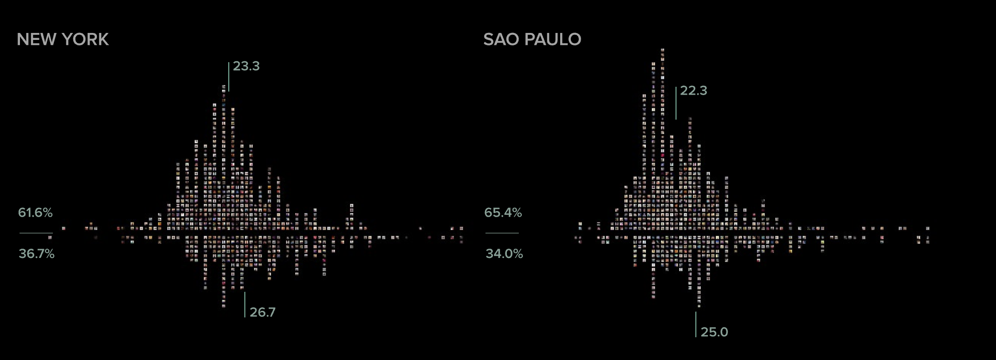

Slide 6
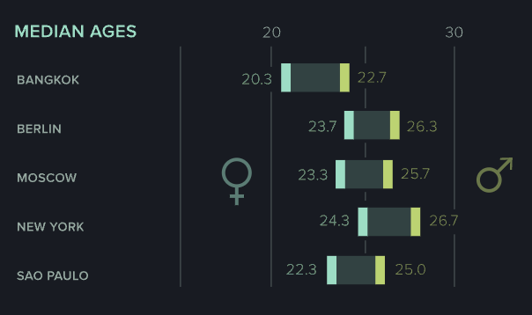
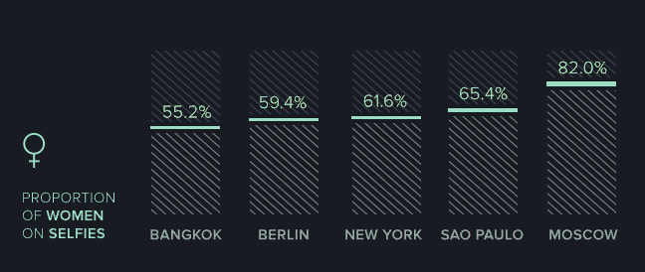

Slide 7
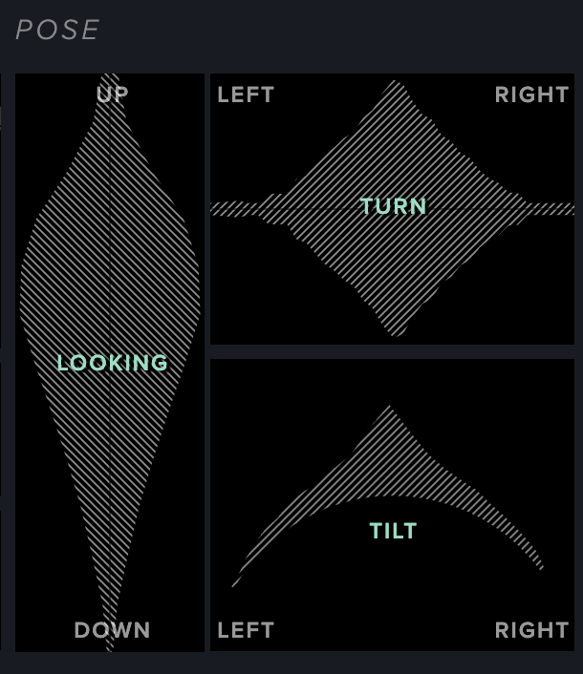
Pose
Little over half people look upwards in their selfies
Most stare straight
Head tilt, majority are centered, but can notice a slight larger distribution to right-tilt

Slide 8
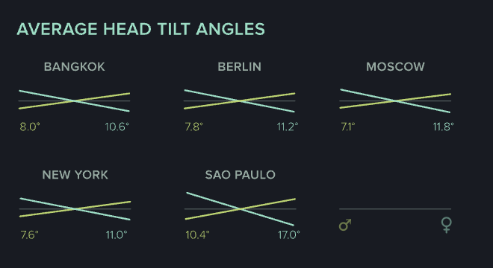

Slide 9
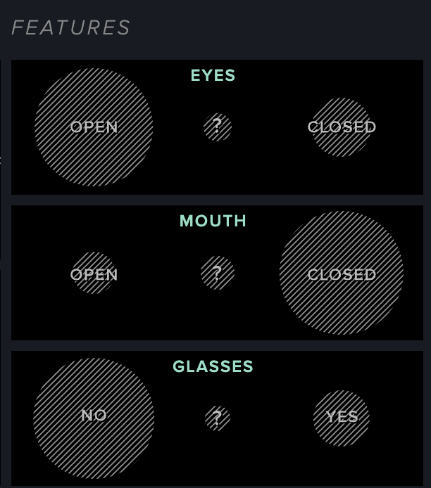
Features
Facial features
Majority are…
Eyes open
Mouth closed(no teeth)
Not wearing glasses

Slide 10
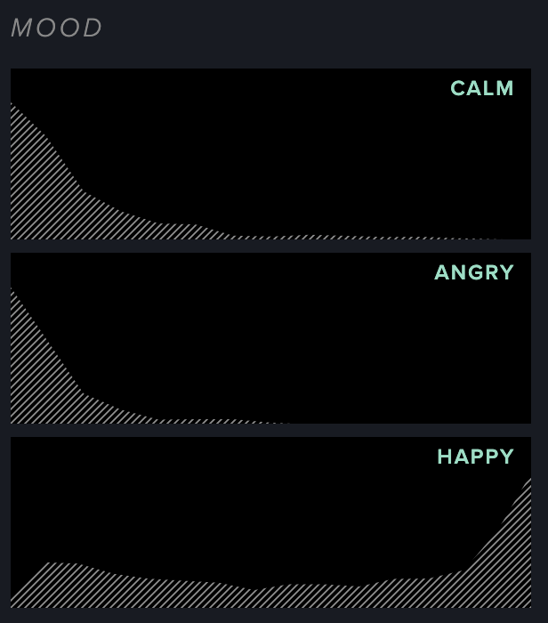
Mood
Majority…
Not calm
Not angry
Average count across happy

Slide 11
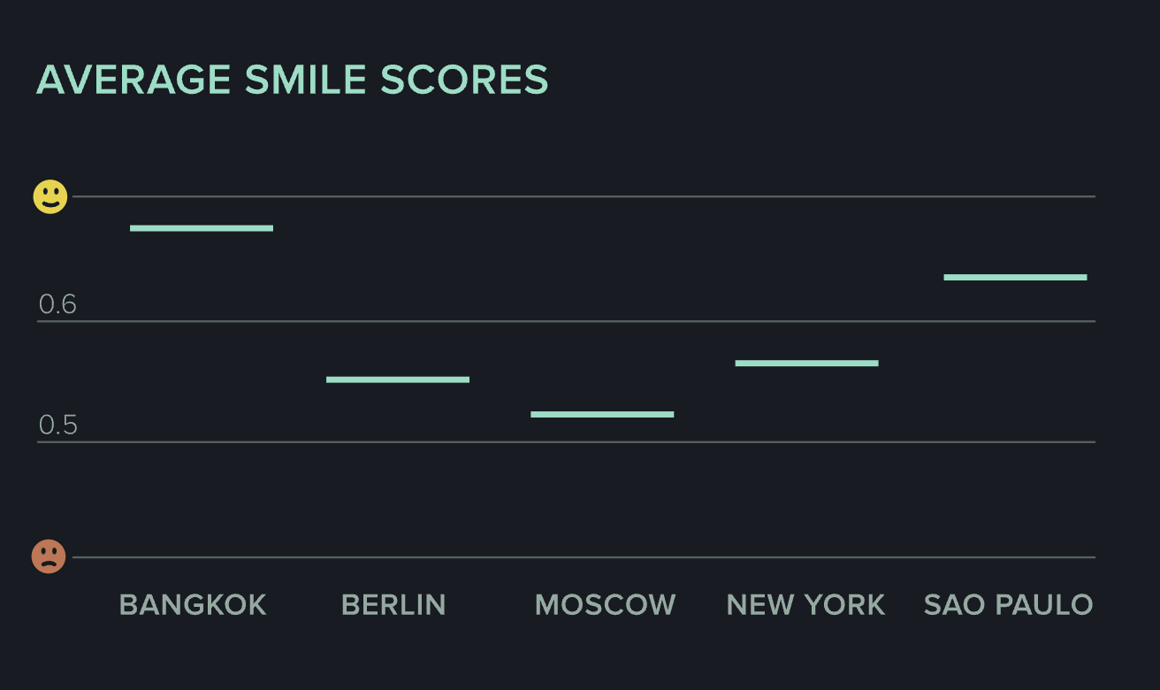

Slide 12
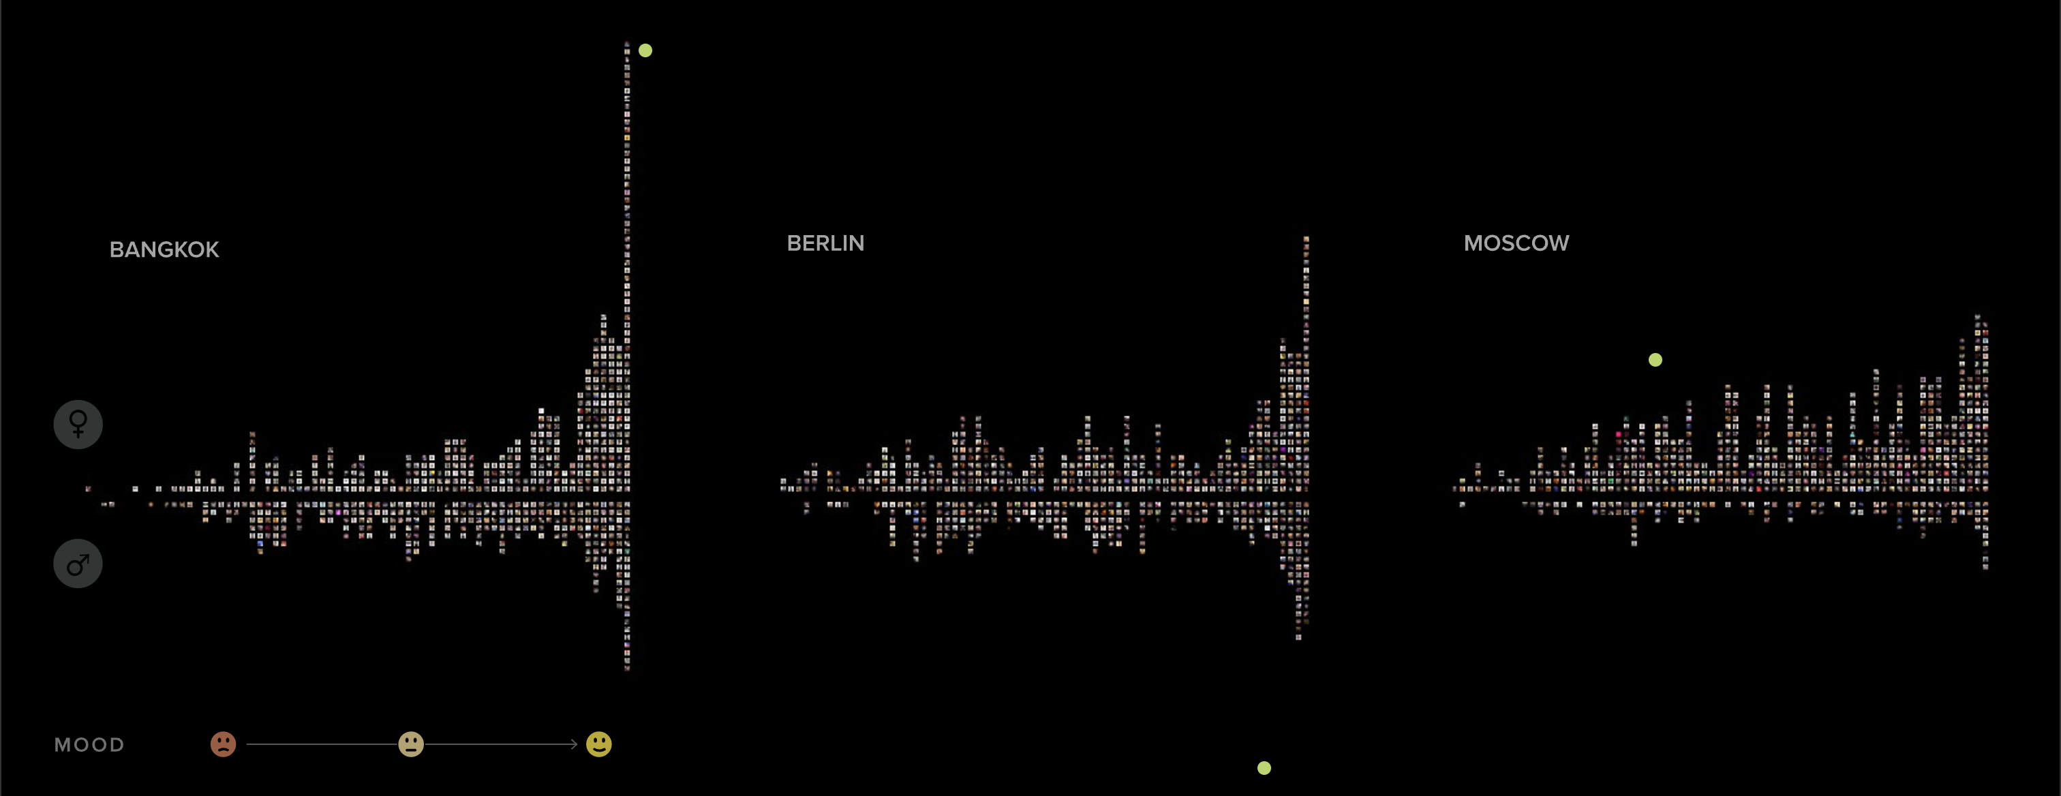
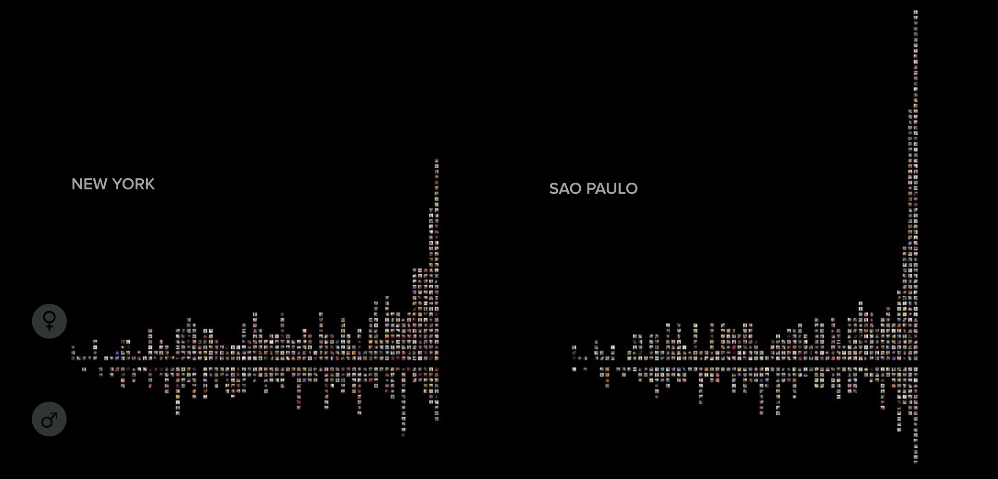

Slide 13
Source
https://selfiecity.net/selfiexploratory/

